Slide 1

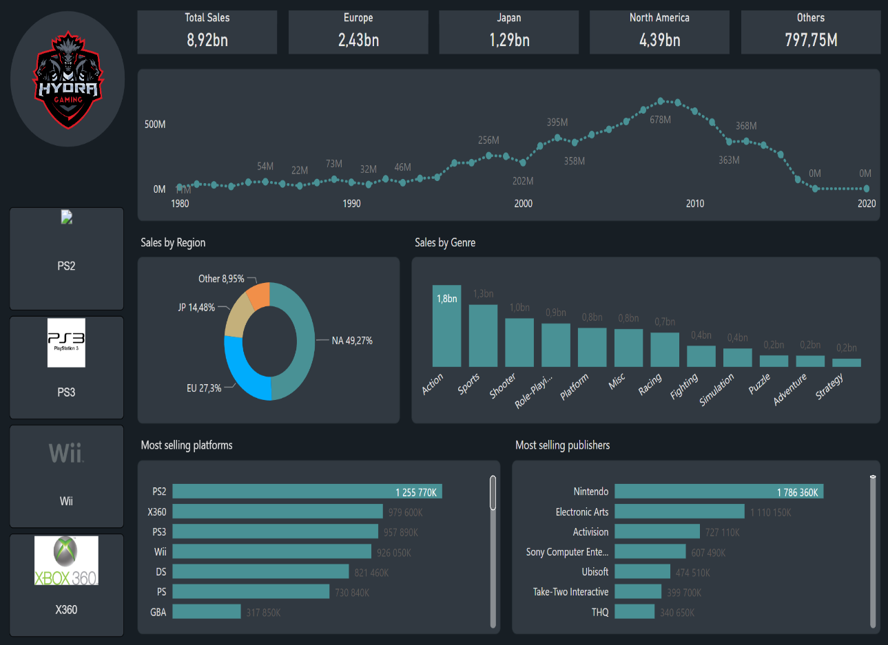
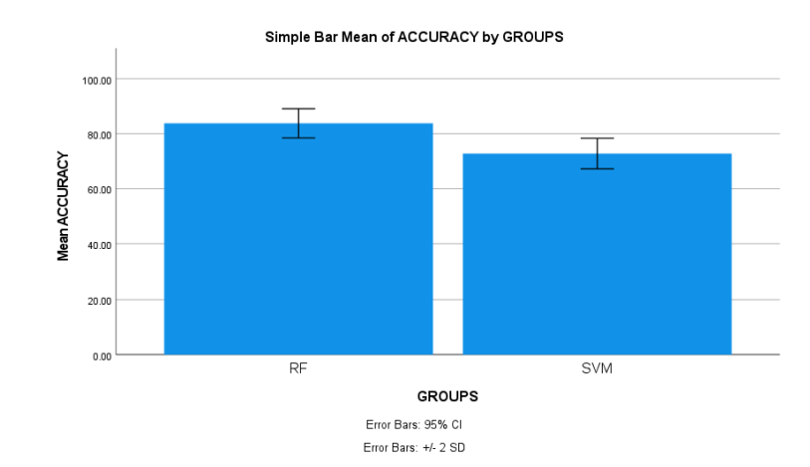
Name: Mr. Jonnalagadda Sai Chandu Register Number: 192211216
Guided by K.V. Kanimozhi
Ms. Poorani.S
Guided by Dr. Mary Valantina. G
Automatic Prediction of Sales in Video Games using Random Forest Algorithm in Comparison with Support Vector Machine Algorithm to Improve Accuracy
INTRODUCTION
This study aims to improve video game sales forecasts using Random Forest and SVM algorithms, ensuring more accurate predictions and making more informed decisions regarding game development and marketing strategies in the gaming industry
The problem in video games sales is lack of accurate sales predictions. This may leads to the risk of overproducing or underproducing games, leading to either excess inventory or missed revenue opportunities
The solution to this problem is identifying the most effective approach for generating accurate sales forecasts in the gaming industry. Moreover, machine learning algorithms like RF and SVM gives better video games sales predictions
Random Forest Algorithm is an ensemble learning technique that constructs multiple decision trees during training and outputs the mode of the classes (classification) or mean prediction (regression) of the individual trees
Support Vector Machine is a supervised learning algorithm used for classification and regression tasks. It works by finding the optimal hyperplane that separates different classes in a dataset while maximizing the margin between the classes
Fig.1 Video games sales prediction
MATERIALS AND METHODS
Sample Size: 20
Group-1 (Random Forest): 10 samples
Group-2 (Support Vector Machine): 10 samples
The samples are tested in SPSS statistical analysis and outputs have been derived
The statistical features extracted are count of samples, mean, standard deviation, minimum and maximum
Non-number data is converted into numerical data for comparison between two algorithms in the dataset
Data Collection
Data
Pre-processing
Splitting data into training data and testing data
Models training (Random Forest & Support Vector Machine)
Performance comparison of Random Forest algorithm with Support Vector Machine for video games sales
Models validation
Fig.2 Flow chart of video game sales prediction using RF and SVM algorithms
RESULTS
Table.1 Group Statistics of RF and SVM Algorithms. It contains mean, standard deviation and standard deviation error
Groups |  | N | Mean | Standard deviation | Standard deviation error
Accuracy rate | RF | 10 | 86.40 | 2.658 | 0.840
 | SVM | 10 | 74.49 | 2.780 | 0.879
In the present work, Random Forest Algorithm is compared with SVM algorithm and it depicts that the Random Forest algorithm gives more accuracy
This Random Forest model attained 86.40% accuracy, on the other hand support Vector Machine Algorithm attained an accuracy of 74.49%
Fig.3 Mean Accuracy Analysis of RF and SVM
DISCUSSION AND CONCLUSION
Based on t-test statistical analysis, the significance value of p=0.001 (independent sample t - test p<0.05) is obtained and shows that there is a statistical significant difference between the RF and SVM. The average accuracy values of two algorithms: Random Forest Algorithm(RF) - 86.40% Support Vector Machine (SVM) - 74.49%
Both methods contributes to improve accuracy, enabling stakeholders to make more informed decisions regarding game development and marketing strategies
Moreover, considering the dynamic nature of the gaming industry, ongoing analysis and adaptation of algorithms will be essential to maintain accuracy in sales forecasting
From the work , it is concluded that the Random Forest algorithm attains the high accuracy when comparing with Support Vector Machine Algorithm in video games sales Prediction
Moving forward, further research could develop deeper into fine-tuning these algorithms for specific genres or target demographics within the gaming market. Additionally, integrating other advanced machine learning techniques or exploring ensemble methods could offer even greater predictive capabilities
BIBLIOGRAPHY
Li, Jianbin, Yufan Zheng, Haoran Hu, Junhui Lu, and Choujun Zhan. "Predicting Video Game Sales Based on Machine Learning and Hybrid Feature Selection Method." In 2021 16th International Conference on Intelligent Systems and Knowledge Engineering (ISKE), pp. 497-502. IEEE, 2021. DOI: 10.1109/ISKE54062.2021.9755343
Cai, Xiaowei, Javier Cebollada, and Mónica Cortiñas. 2022. “A Grounded Theory Approach to Understanding in-Game Goods Purchase.” PloS One 17 (1): e0262998 DOI: 10.1371/journal.pone.0262998
Conde-Ripoll, Rafael, Diego Muñoz, Adrián Escudero-Tena, and Javier Courel-Ibáñez. 2024. “Sequential Mapping of Game Patterns in Men and Women Professional Padel Players.” International Journal of Sports Physiology and Performance, February, 1–9. DOI: 10.1123/ijspp.2023-0484
Etchells, Peter J., Alexandra L. Morgan, and Daniel S. Quintana. 2022. “Loot Box Spending Is Associated with Problem Gambling but Not Mental Wellbeing.” Royal Society Open Science 9 (8): 220111. DOI: 10.1098/rsos.220111
Doran, John P. 2023. Unity 2023 Mobile Game Development: Discover Practical Techniques and Examples to Create and Deliver Engaging Games for Android and iOS, 2nd Edition. Packt Publishing Ltd. DOI: 10.1007/s10964-024-01950-7

